Slide 1


PokéTheory
by
Giorvanny Lindor
4/26/2022

Slide 2


Table of Contents
About Me
Application Overview
Database Relationships
User Story
Application Demo
Software Testing
Questions

Slide 3
Meet the Developer
IT Professional Worked at Private Equity firm Nautic Partners, LLC under their Senior IT Analyst. We were a two-man IT team for the entire firm, which gave me in-depth exposure to Sysadmin work in the high finance world.
No Prior Programming I’m a newbie. I learned Java, SQL, HTML, CSS and JavaScript all this year, and I look forward to continuously growing my ability in Java as an engineer.
Amateur Graphic Designer For the past decade, I’ve used Adobe tools such as Photoshop, Premiere, and Lightroom nearly every day. Utilizing a Wacom digitizer, I’ve created numerous digital art pieces, and I use a Sony FE 35mm F1.4 GM lens for photography.

Slide 4
Application Overview
For this Full-Stack Web Development project, I have created a Pokémon website. Users can register, login, and begin building their very own Pokémon team using. Their team can be read, updated, or deleted to their liking. Each team has a maximum number of 6, as is standard for Pokémon battling format, and Pokémon of a team must be unique.

Slide 5
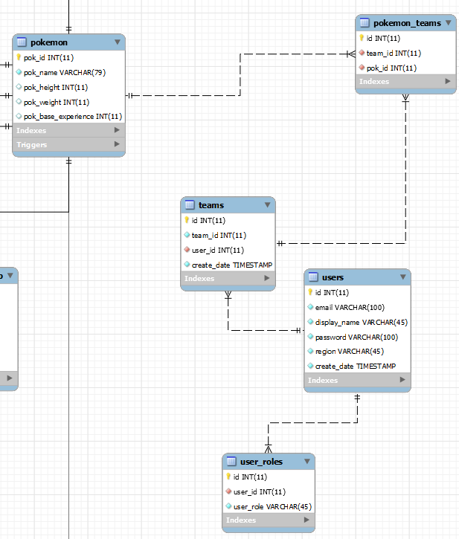
Database Relationships

Slide 6
Application Demo!

Slide 7
Software Testing

Slide 8
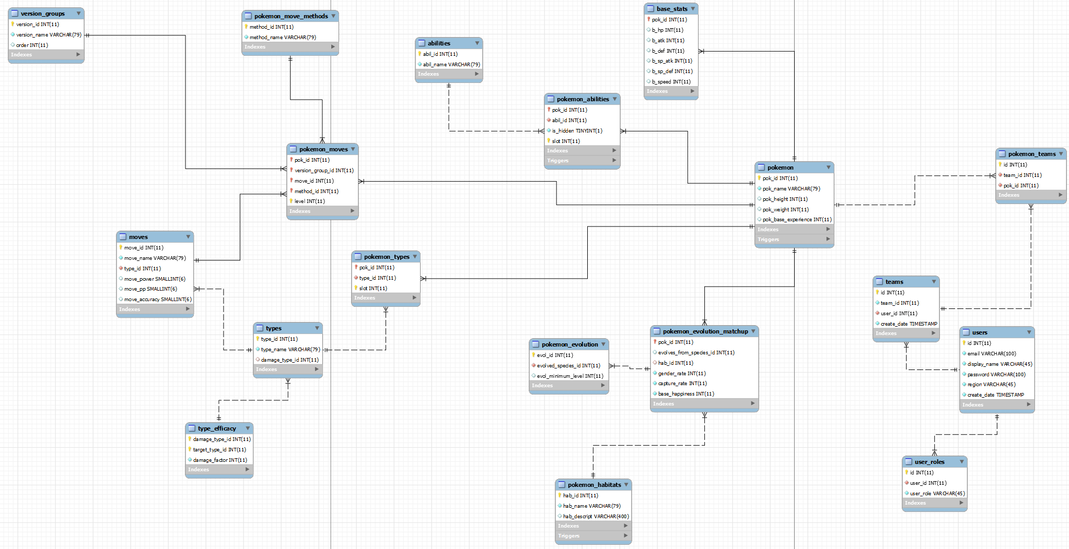
Potential

Slide 9
Q/A
Ask me anything

Slide 10
Thank you!

